Slide 1
Turing Completeness and Template Metaprogramming
Tom Peters
thomas.d.peters@gmail.com
tdp2110 on slack, github
Feb 21, 2019

Slide 2
Outline
Turing Completeness
C++ Metaprogramming crash course
Proving Turing completeness of Template Metaprogramming
Notes:
Feel free to interrupt with comments or ask questions

Slide 3
Part 1: Turing Completeness

Slide 4
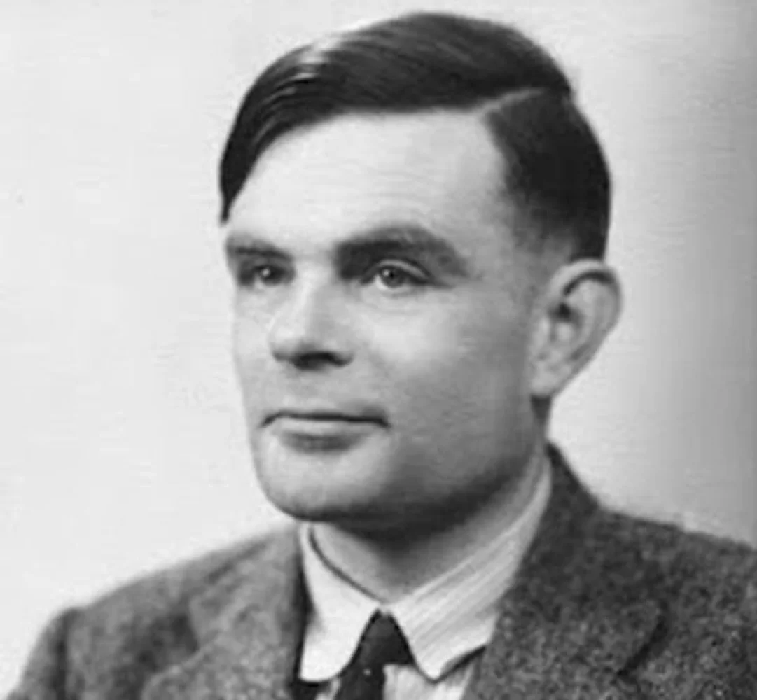
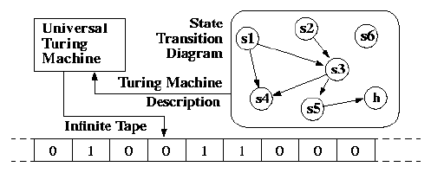
Turing machines
Alan Turing, 1936

Slide 5
Turing Completeness
(Universal) Turing machines
Most modern programming languages:
C++
Python
Haskell
...
μ-recursive functions
All equally powerful
λ-calculus
Church Turing Thesis: hypothesis that *anything* mechanically computable is computable by a Turing machine.

Slide 6
Compile time C++ is Turing Complete
1994 Erwin Unruh: enumerating primes at compile time
Boost Spirit, Qi: compile time parser generators
Boost Proto: compile time embedded DSL generation
Expression templates (eg, Eigen linear algebra library)
2017: Compile time ray tracing
2018: Compile time ARM emulator
2018: Compile time regular expressions
Notes:
There are other examples of metaprgramming: tetris, but much metaprogramming happens behind the scenes, in libraries like boost, ranges, or stl, for things like class generation.

Slide 7




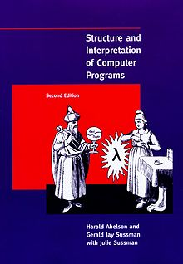

Slide 8
Lisp
1958 (one year younger than fortran!)
Innovative as heck:
Garbage collector
Recursion
Conditionals
REPL
Continuations
Multiple dispatch
...

Slide 9

Homoiconicity
Metacircular evaluation

Slide 10
Part 2: C++ Template Metaprogramming
Notes:
There are roughly 3 types of template metaprogramming: value based, type based, and mixed

Slide 11
C++ Templates: parameterized types
template <class T> class Vector { … }; | Vector<int> vector_of_int; Vector<float> vector_of_float;
template <int i> class IntegralConstant { … }; | IntegralConstant<1> one; IntegralConstant<2> two;

Slide 12
Template specialization
template <class T> class Vector { … }; | // "primary template"
template <> class Vector<bool> { … }; | // specialize for vector of bool Vector<bool> vector_of_bool;
template <class T1, class T2> class Vector<Pair<T1, T2>> { … }; | // can specialize on patterns // of types

Slide 13

Member typedefs
template <class T> class Vector { public: using element_type = T; }; | Vector<int>::element_type i; // i has type int
template <class T> class Foo { using bar_type = Vector<T>::element_type; }; | // compiler error: expected typename before Vector<t>
using bar_type = typename Vector<T>::element_type;

Slide 14
Metafunctions (via alias templates)
template <class T> class Vector { public: using element_type = T; };
template <class T> using vector_element_type = typename Vector<T>::element_type;
vector_element_type<int> i; // i has type int vector_element_type<bool> b; // b has type bool
Notes:
This is not very interesting … but it becomes interesting when combined with template specialization.

Slide 15
More interesting metafunction:
template <bool, class IfTrue, class IfFalse> struct If;
template <class IfTrue, class _> struct If<true, IfTrue, _> { using type = IfTrue; }; template <class _, class IfFalse> struct If<false, _, IfFalse> { using type = IfFalse; }; If<false, int, float>::type f; If<true, int, float>::type i;

Slide 16
Typelists
template <class … Ts> struct TypeList {};
template <class T> struct HeadImpl; template<class T, class … Ts> struct HeadImpl<TypeList<T, Ts …>> { using type = T; }; template <class T> using Head = typename HeadImpl<T>::type;
using Types1 = TypeList<int, float>; Head<Types1> h1;
using Types2 = TypeList<>; Head<Types2> h2;

Slide 17
Typelists: searching
template <class … Ts> struct TypeList {};
template <class T, class List> struct ContainsImpl { static constexpr bool result = false; } template <class T, class … Ts> struct ContainsImpl<T, TypeList<T, Ts …>> { static constexpr bool result = true; }; template <class T, class H, class … Ts> struct ContainsImpl<T, TypeList<H, Ts …>> { static constexpr bool result = ContainsImpl<T, TypeList<Ts…>::result; }; template <class T, class List> static constexpr bool Contains<T, List> = ContainsImpl<T, List>::result;

Slide 18
static_assert
Introduces compile-time error if a (compile time) condition fails to hold:
#include <type_traits> // for std::is_same_v static_assert(std::is_same_v<int, If<true, int, float>::type>); // passes static_assert(std::is_same_v<float, If<true, int, float>::type>); // compile-time error

Slide 19
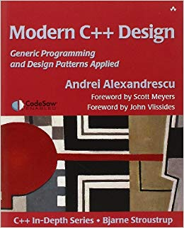
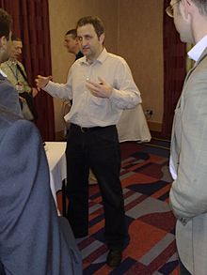
If you're interested in practical metaprogramming ...
From 2001!
Notes:
Here's andrei, looking like a vampire. Is that a cape???
To prove turing completeness of TMP, you can directly implement a universal turing machine. But in my opinion, it's not extremely elegant

Slide 20


Libraries for metaprogramming
Boost MPL: STL-modeled. "Old school"
Boost Hana: modern take
Louis Dionne

Slide 21
Part 3: Turing Completeness of TMP
Notes:
We're going to implement a (functional) subset of the Scheme dialect of Lisp, using type-based template metaprogramming. In other words, we're going to represent all lisp VALUES by C++ types. Scheme has booleans, ints, strings, closures, lists ...

Slide 22
Booleans
template <bool> struct Bool {}; using True = Bool<true>; using False = Bool<false>;

Slide 23
Integers
template <int> struct Int {};

Slide 24
Lists
template <class Car, class Cdr> struct Cons {}; struct EmptyList {};

Slide 25

Strings
Notes:
Now let's talk about syntactic constructs

Slide 26
S-Expressions:
template <class Operator, class... Operands> struct SExp {}; // (some) built-in operators: enum class OpCode { Add, Sub, Mul, Eq, Neq, Leq, Neg, Or, And, Not, Cons, Car, Cdr, IsNull }; template <OpCode op> struct Op {};

Slide 27
Variables
template <int> struct Var {};

Slide 28
Lambdas (and closures)
template <class Body, class... Params> struct Lambda {}; template <class Body, class Environment, class... Params> struct Closure {};

Slide 29
To the CLI!
(using https://github.com/tdp2110/TmpLisp)

Slide 30
An example: (+ 1 2)
Eval<SExp<Op<OpCode::Add>, Int<1>, Int<2>>>;
typename Eval_<SExp<Op<OpCode::Add>, Int<1>, Int<2>>>::type;
Apply<Eval<Op<OpCode::Add>>, Eval<Int<1>>, Eval<Int<2>>>;
Apply<Op<OpCode::Add>, Int<1>, Int<2>>;
Int<1 + 2>;
Int<3>;

Slide 31
Example: (let ((x 2)) (+ 1 x))
Eval<Let<Env<Binding<Var_x, Int<2>>>, SExp<Op<OpCode::Add>, Int<1>, Var_x>>, EmptyEnv>;
Eval<SExp<Closure<SExp<Op<OpCode::Add>, Int<1>, Var_x>, Env<Binding<Var_x, Int<2>>>>
Apply<Closure<SExp<Op<OpCode::Add>, Int<1>, Var_x>, Env<Binding<Var_x, Int<2>>>>
Eval<SExp<Op<OpCode::Add>, Int<1>, Var_x>, Env<Binding<Var_x, Int<2>>>>
Eval<SExp<Op<OpCode::Add>, Int<1>, Eval<Var_x, Env<Binding<Var_x, Int<2>>>>
Eval<SExp<Op<OpCode::Add>, Int<1>, Eval<Var_x, Env<Binding<Var_x, Int<2>>>>
Eval<SExp<Op<OpCode::Add>, Int<1>, Int<2>>>
Int<3> // from previous example

Slide 32
Greenspun's tenth rule of programming:
"Any sufficiently complicated C or Fortran program contains an ad-hoc, informally-specified, bug-ridden, slow implementation of half of Common Lisp."
credit??

Slide 33
Future directions
Stateful operations
Compile time parsing? :)

Slide 34
Thanks! Questions?

